Slide 1

SmartAcad AI - An Assignment Tracking and Submission Assistant
SOA Project Review-1
Date& Time
 | Under the Guidance of Dr. Neelima Gogineni Department of Computer Science and Engineering, KLH CSE Bowrampet Campus
Team Members Name Roll Number M. Haswanthi 2420030143 K. Akshitha 2420030146 K. Sreevardhan 2420030711

Slide 2
Outline of Project Work
Focus
Introduction
Literature Survey
Challenges
Research Objectives
Conclusion & Future Work
References
Publications Details

Slide 3
Problem Statement
Students often have to manage assignments from multiple subjects, each with different deadlines, priorities, and submission requirements. Using notebooks, messages, spreadsheets, or separate applications to remember these tasks can make it difficult to maintain a clear view of pending and completed work. As a result, students may forget deadlines, submit assignments late, or struggle to decide which task should be completed first.

Slide 4
Objectives
Manage all assignments in one place – Students can organize assignments from different subjects on a single platform.
Keep track of deadlines – The system helps students remember upcoming submission dates and avoid missing deadlines.
Prioritize assignments using AI – AI helps identify important and urgent assignments based on their deadlines and priority.
Get smart reminders – Students receive reminders about upcoming deadlines, pending work, and overdue assignments.
Track assignment status – Students can easily check whether an assignment is pending, submitted, completed, or overdue.
Monitor academic progress – The system provides an overview of completed and pending assignments to help students manage their workload.
Support faculty management – Teachers can create assignments, set deadlines, and monitor students' submission status.
Use microservices architecture – Different functions are handled through separate services, making the system easier to maintain and expand.
Improve student productivity – The system helps students stay organized, complete assignments on time, and reduce missed submissions.

Slide 5
Literature Survey
Authors | Title of the Paper | Methodology | Inferences | Limitation/Future work
Hilal et. al. [3] | Intelligent Epileptic Seizure Detection and Classification Model Using Optimal Deep Canonical Sparse Autoencoder, Biology, 2022-mdpi | Coyote optimization algorithm (COA) for feature selection Krill herd algorithm (KHA) for parameter tuning | intelligent deep canonical sparse autoencoder-based epileptic seizure detection and classification model using EEG signals. It achieves a maximum accuracy of 98.67% and 98.73% under binary and multi-classification, respectively. | The paper does not mention the specific limitations of the proposed DCSAE-ESDC technique or the experimental analysis conducted using the benchmark epileptic seizure dataset
Made Asri Syaiba Almihda Hasan, Faradiba Isqi Al-Azizih & Ahmad Hamdani [1] | Designing an Online To-Do-List System to Support Student Productivity in Managing Lecture Assignments and Islamic Boarding School Activities, JAIEA, 2026 | • Developed a web-based To-Do-List system for managing academic assignments and other activities. • Used the Prototype Method to continuously collect user feedback. • Included task recording, schedule reminders, and activity progress monitoring. | • Provides a centralized way for students to record and organize academic tasks. • Reminders help students manage deadlines and activities. • Progress monitoring supports better productivity and task organization. | • The system mainly focuses on task management and reminders. • Future work can include AI-based task prioritization and personalized recommendations to provide more intelligent assistance.

Slide 6
Problem Gap Identification
Most existing systems only help students store assignments and deadlines.
They usually give basic reminders but do not understand which assignment is more urgent.
There is limited use of AI to analyze deadlines, workload, and help students decide what to do first.
Assignment submission status and academic progress are not always managed together.
Many systems mainly focus on students and provide limited support for teachers to manage assignments and submissions.
Existing solutions often work as separate features instead of providing one complete platform.

Slide 7
Innovation, Creativity, and Novelty
AI-Based Academic Assistant:
Helps students manage their assignments using AI and gives useful suggestions.
Smart Task Prioritization:
Helps students know which assignment to complete first based on deadline and importance.
Smart Reminders:
Sends reminders for upcoming and overdue assignments so students do not miss deadlines.
Complete Assignment Tracking:
Keeps assignment details, deadlines, submission status, and progress in one place.
Student and Faculty Support:
Teachers can create assignments and set deadlines, while students can view and track their submissions.
Personalized Support:
Gives suggestions based on the student's pending assignments and workload.
One Centralized Platform:
Combines assignments, reminders, submissions, and progress tracking in a single system.
Microservices-Based Design:
Uses separate services for assignments, users, notifications, submissions, and AI, making the system easy to manage and expand.
Improved Student Productivity:
Helps students stay organized, manage their time, and complete assignments on time.

Slide 8
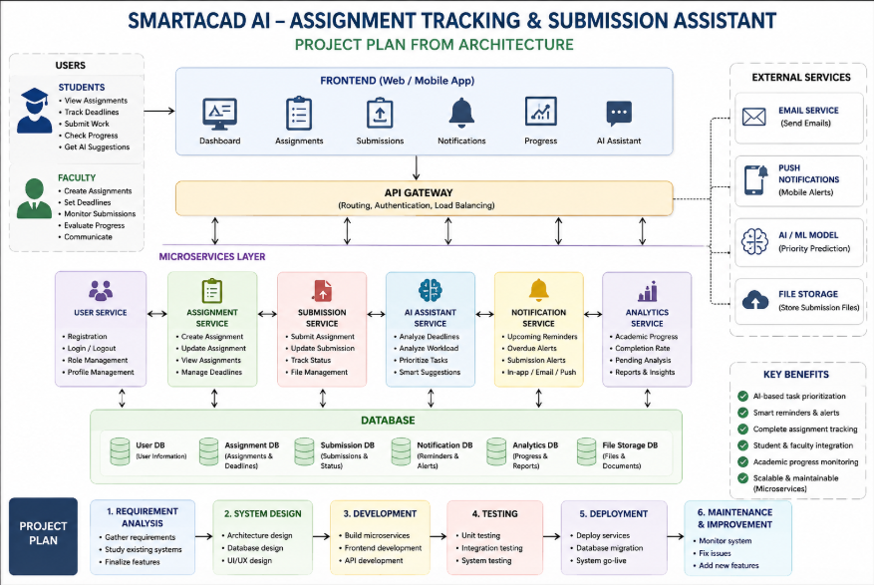
Feasibility and Project Plan

